Slide 1

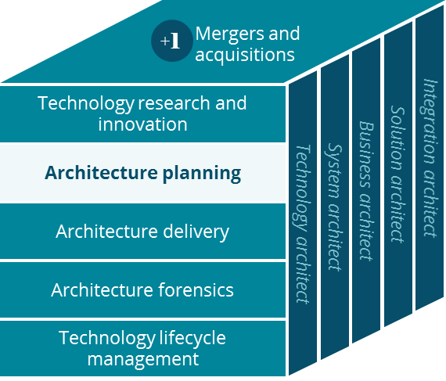
Commercial- Small Group Business Canvas
Architecture Planning
Grace Lee
3/2019

Slide 2
Business Canvas
Small Group
Sales / Service / Delivery
Key Partnerships
Key Activities
Value Proposition
Customer Relationships
Customer Segment
Clearing House
PBM
Prospect Customers
Manage Account
HR
Clinical professionals
Providers
Full Insured Admin
Self Insured Admin
Better & Easy Service
Employees
Plan sponsors
Deliver Service
Manage Network
Lower Member Cost
Employee Department
Small Group
Fully Insured
Brokers
Hospitals
Pay Providers
Brand Recognition in local
Joint Venture
Vendors
Channels
Small Group
Self Insured (ASO)
Key Resources
Quality of Service
Digital
(Aetna Health)
Mail
ACO
States
Local Presence
CVS / Aetna Brand
TPA
Auxiliary Product Outsource
Digital Platform
Data & Insights
Digital Assets
Vendor Portals
Face to face
IT Platform
Preventative Health Care
Local Presence
Phone, Fax, Chat & Emails
Video (TeleDoc)
Local Community
Minute Clinic
Customer Care
Cost Structure
Revenue Streams
Marketing & Sales
Operational Costs
Research & Development
General & Administrative Costs
PMPM (Per Member Per Month)
PMPM ASO
AFA (Aetna Funding Advantage)
Long Term Investment
Notes:
For Individual and Small group, brokers and local agents handle sales, and Aetna provides pre-defined products with no customizations
We promise cost down and local market presence, but no guarantee (guarantee – financial penalty for national accounts)
Very price sensitive, very competitive space, brand recognition (because of large account) in local market (better local relationships) is important when price is the same,
For prospect, national account will helps… after on-boarding, local presence and good rates

Slide 3
Glossary
Glossary | Description
Clinical professional | Pharmacists, nurse practitioners, community liaisons and social works
IPA | Individual Partitional Association
ASO | Administrative Services Only
ACO | Accountable Care Org
Stop-loss insurance | Aetna provides stop-loss insurance for national account and middle market ASO. Stop-loss insurance is based on cash flow monthly for claims.
AFA | Aetna Funding Advantage for small group
ACC | Aetna Community Care. Face to Face = Minute Clinic, Pharmacy, ACC
TPA | Third Party Administrator
Providers | Providers, Hospitals, Clinical Professionals
Auxiliary Product Outsource | Vision and Dental Partnerships for Care and Wellness
Value Proposition | Based on Better Service, Easy Service, and Lower Cost

